Slide 1
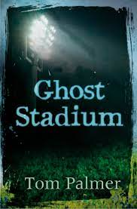
Teacher support slides
Ghost Stadium

Slide 2
Synopsis
Lucas, Irfan, and Jack want to mark the beginning of their summer holidays in style! With a camping cover story, the boys sneak into the old abandoned football stadium to spend the night. Are the rumours about it being haunted true? They’re about to find out.

Slide 3
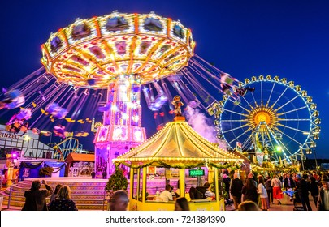
How could you describe these common places to show that they are ‘forgotten’ or deserted?

Slide 4
Page 14 - How is tension/ intrigue created
“No!” Lucas said to himself. “This can’t happen.”
He had to take control.
But as he opened his mouth to shout to Jack, he saw something else.
A flicker in the corner of his eye.
A dark shape.
A shape that looked like a man falling.
Notes:
Focus particularly on sentence structure and organisation. – Lucas’ determined attitude at the start of this extract is then contradicted when he sees something. The simple sentences giving only one action build up the intrigue because the writer is not giving us lots of description but is moving from one thing to another quickly ( like his eyes would as he saw the ‘thing). The repetition of the noun ‘shape’ shows that Lucas is unsure of what he sees and this also adds intrigue as we too want to know what he has seen too.

Slide 5
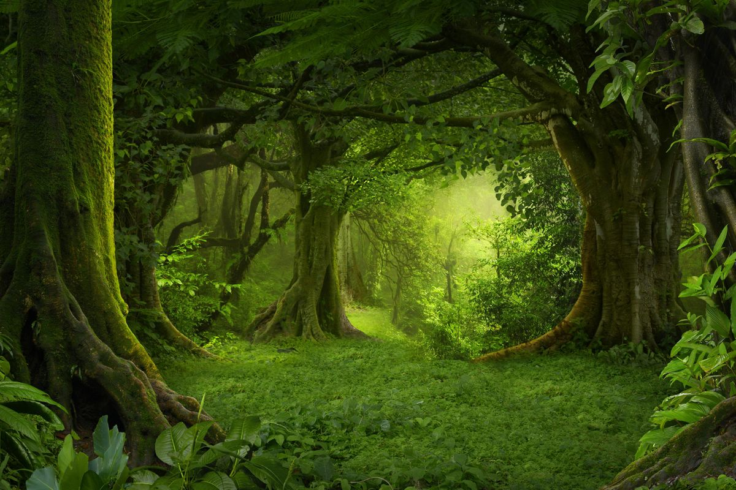
Stimulus material

Slide 6
Can you remember the meaning?
4
Points
Corrugated iron
3
Points
Demolished
Turnstiles
2
Points
Lever
secure
Straddled
1
Point
Risky
Concentrated
Tenerife
muttered

Slide 7
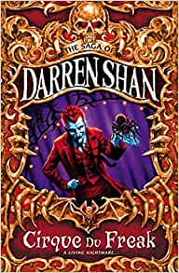
Darren Shan
Born in London in 1972, Darren Shan (real name Darren O'Shaughnessy) has lived in Ireland since the age of six. He completed his first novel, Mute Pursuit, at just 17. Over the years that followed he juggled his writing with college and work, averaging a book a year, before leaving his job to write full time.
Shan's vampire saga ran to 12 novels, made up of 4 trilogies (The Vampire Blood Trilogy, The Vampire Rites Trilogy, The Vampire War Trilogyand The Vampire Destiny Trilogy), and spawned the spin-off series, The Saga of Larten Crepsley. This was then followed by his 10-part demon series The Demonata.
By 2006, his books were available in every continent - on sale in 30 countries in over 20 languages. His novels had featured in children's bestseller lists in the US, the UK, Ireland and Europe.
2008 saw the publication of Shan's first adult novel. Procession of the Dead was the first in The City Trilogy, a cycle of gritty urban modern-noir fantasy tales.
Shan's latest series, Zom-B, follows the adventures of zombie, B, as he tries to make sense of the world after waking up in a military facility after a zombie attack.

Slide 8
Darren Shan clip
https://www.youtube.com/watch?v=aUFqki1ybIw – Darren Shan reading from his book Zom-B *warning please view before showing pupils to ensure it is suitable for your cohort*

Slide 9
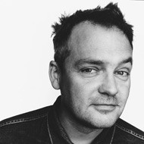
Charlie Higson
Charles Murray 'Charlie' Higson is an English actor, comedian, author and former singer. He has also written and produced for television. Higson was educated at Sevenoaks School and at the University of East Anglia where he met who would become his bandmates in 'The Higsons'. They released two singles.
Higson then became a decorator, then began writing and performing comedy. He came to attention as one of the main writers of the BBC 2 sketch The Fast Show.
Higson published many novels through the 1990s which took a slightly dystopian look at everyday life, centering around characters teetering on the edge of society and finding themselves to be out of control, following in the footsteps of Aldous Huxley and George Orwell in their 'new worlds.' In 2004, Higson created the Young Bond series of James Bond novels, aimed at younger readers and concentrating on Bond's school days. The first novel was SilverFin, and was followed by four more novels, all written by Higson.
Higson also wrote a zombie-horror series of books for younger readers. The first book was called The Enemy.
Higson lives in London with his wife and children.

Slide 10
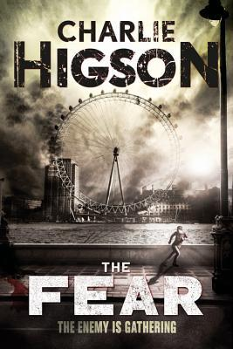
Blurb – The Fear – Charlie Higson
The sickness struck everyone sixteen and over. Mothers and fathers, older brothers, sisters, and best friends. No one escaped its touch. And now children across London are being hunted by ferocious grown-ups who are hungry, bloodthirsty, and not giving up. DogNut and the rest of his crew, in search of the friends they lost during the fire, set off on a deadly mission from the Tower of London to Buckingham Palace and beyond, as the sickos lie in wait. But who are their friends and who is the enemy in this changed world?

Slide 11
What is the writer suggesting is happening in chapters 20&21
The term infer means that you make a guess about what is happening based on the information that you are given.
In these chapters, nothing is said directly about what has happened to Jack but lots can be deduced (worked out) by what is inferred (suggested).
Since the text says…… it is inferred that…..
The chapter tells me …….. so it makes me think……
When I read……. I guess that it means…….

Slide 12
What is a Tsunami?
A tsunami is a series of waves caused by earthquakes or undersea volcanic eruptions. ... But as the waves travel inland, they build up to higher and higher heights as the depth of the ocean decreases. The speed of tsunami waves depends on ocean depth rather than the distance from the source of the wave.
The boys are in a football stadium. Could there be a real Tsunami here?
Writers sometimes use the term Tsunami in a figurative way – to describe the mood of a scene.
Here are some examples of the word used in descriptive writing:
The tsunami of grief swept over me.
The crowd entered the open gate like a tsunami.
Can you write your own simile or metaphor using tsunami?

Slide 13
Retrieval Practice Challenge Grid
eager | Massage table | ceased
edge (verb) | vice | toxic
dazed | wilderness | void
coma | tsunami | instinct
One Point – most recent chapters | Two Points – Chapters 25-17 | Three Points- Chapter 14-22 | Four Points - Further back

Slide 14
Key themes – what event in the novel represent these key themes?
Friendship
Taking risks
Fear/isolation
Death
Deception
Strength of mind

Slide 15
Step 2 - Option writing task
Write an example of the following:
An adjective to describe being afraid –
A verb to show fear –
An adverb to describe the verb you have chosen –
A simile that shows fear –
A setting that appears ‘normal’ but could be scary in a different context (e.g. the football stadium is normal, but abounded at nighttime is scary)

